Slide 1
Vaishnavi Global Private Limited “A matter of elegance”
VG
SEDEX and SAAP driven leading apparel Manufacturing and Export house from India.
Corporate Presence: C 237/239, Turbhe MIDC, Turbhe, Navi Mumbai - 400705
Notes:
Presented by:

Slide 2
Index
VG
Company,
Milestones,
Manufacturing,
Services,
Products,
Clientele & Brands,
Certifications,
Accreditations,
Quality Standards,
Testimonials,
Forthcomings and
Thanking Note

Slide 3
Company : Vision
VG
“To establish Vaishnavi as one of the most elegant brand present in every wardrobe”

Slide 4
Company : Mission
VG
“To cater the fashion industry with innovative quality and become a brand synonym of excellence”

Slide 5
1 - Company : Profile
VG
Vaishnavi Global Pvt Ltd “Vaishnavi” is a premium denim apparel manufacturer, catering to largest and renowned Indian and International fashion brands and retailers across the globe. Since Inception “Vaishnavi” has grown with a commitment to provide best of quality and become a synonym of prompt servicing to its client. “Vaishnavi” has been instrumental in providing of manufacturing support to some of the best renowned brands in Indian and also provide them the corresponding quality they are known for. “Vaishnavi” is committed to a simple mantra of quality service.
Our diverse and value integrated approach has seen us go from strength to strength. To enable the market with styles and designs that creates brand loyalty. Since inception in year 2004 incorporated as Ambika Dyers Pvt. Ltd., we have remained committed to bring fashion to masses. Continuously delivering high-end quality with economic approach of time and money through processing and procurement from high quality denims from mills in India and abroad with a State-of-the-art facilities and constant reinvention in technology and skill set.
.

Slide 6
1- Company : Profile
VG
At “Vaishnavi” we believe that directional changes in the market must be matched with innovation. We constantly strive for better solutions, environmentally friendly products, quality and productivity by investing heavily in infrastructure, technology and human resources. We work towards identifying new market trends, brands and adaptability in manufacturing process and end products, our innovative approach is satisfying the demands form the diverse and blue chip clientele.
Since washing plays a critical role in fashion denims that demarcates the brands and provide a leading edge in the market hence we have installed two washing units that specialize in the latest washes. We have an association with expert firm in Turkey that keeps us abreast with the latest washes in the market and production thereon. Brands like Pepe, Raymonds, Klix, Nostrum, Future, Reliance, Mufti and Myntra are few of our esteemed clients.

Slide 7

1 - Company : Management
VG
Mr. Rishi Mehra – CMD :
Being a Bachelor in Engineering he has founded the company in the year 2004. Since inception he has been a continuous foundation of repute with diverse outlook. His core competence during these years in the areas of Brand Building, Business Development, International Marketing and International Trading, Marketing Strategy Formulation and Management of Assignment has brought excellence to it. Aged at 47 he is been very energetic to manifest his vision of setting up multiple manufacturing unit.
His professional skills in the corporate sector are the witness of quick reception and refinement with the change in the industry to solve key marketing and business matters with new path breaking ideas and elevated energy level of performance. He has been an inspiring force in all his group companies lead by him and proven his track with ever growing turnover and bottom lines of the company.

Slide 8
1- Company : Management
VG
Mrs. Priti Mehra – Managing Director :
Being a postgraduate in Management and Bachelor in Commerce she has been instrumental in decisions pertaining to the Human Resource, Admin and Finance department. Her core competence during her tenure of work of more than two decade is in the areas of Finance, HR and Admin had been witness of issue solving approaches with the quick executions of new assignment and team management. She has always been a strong source of inspiration for the company management and personnel.
She is actively involved in day-to-day Finance and HR related matters of the company. She handles the corporate office of the company. She is also actively involved in international liasioning for future growth of the company and in day-to-day involvement in the technical affairs related to the process and systems up gradations. She give a good time to philanthropic activities.

Slide 9
1- Company : Management
VG
Mr. Majid Ansari– Head of Operations
Mr. Majid has been a source of guiding force in the team for the productions and over all management of the company. He is managing over all operations of the company with business acumen along with the vigilant eye on the compliance matters related with the labour and other personnel.
He has always been a strong force behind the timely productions and satisfactory dispatches to our esteemed clients. He has been ably maintaining the reputation of the company in terms of its quality provisions and operational ethics. He has been actively involve in the labor welfare and Social responsibilities of the company.

Slide 10
1- Company : Team
VG

Slide 11
2- Milestones:
VG
Corporate office
Factory 2
Certified
Acquired an office space in Andheri, Mumbai
Acquired factory MIDC, 50000 sq. ft.
Sedex certification
2005
2019
2005
2010
2012
2014
Incorporations
Factory 1
Financial Leverage
Incorporated at Mumbai
as washing & dying unit
Acquired a factory space Turbhe MIDC, 50000 sq. ft.
Company has achieved a turnover twice of previous year
Process
SAP driven system introduced
2021

Slide 12
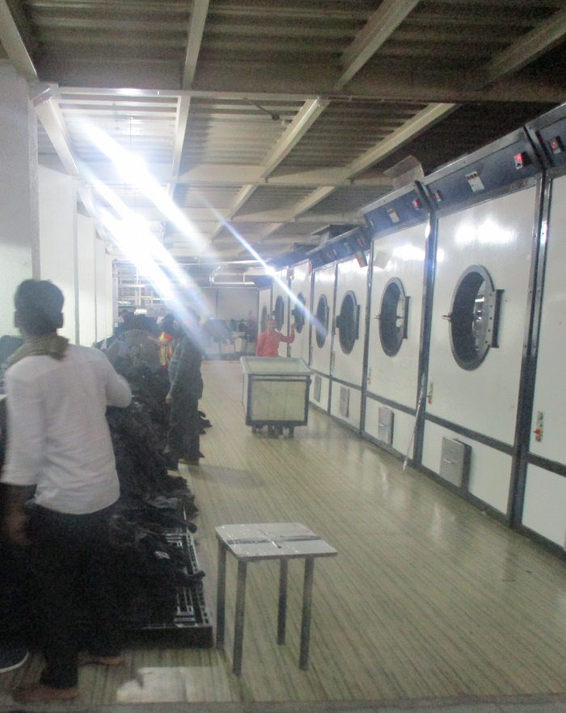
3- Manufacturing: Washing & Dyeing
VG
p]p]p]p]

Slide 13
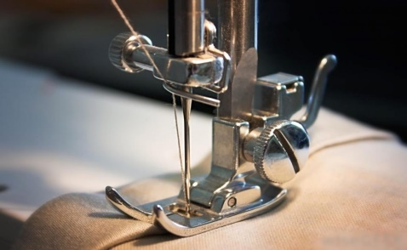
3- Manufacturing: Cutting & Stitching Lines
VG
p]p]p]p]

Slide 14
3- Manufacturing: Finishing & Packing Lines
VG
p]p]p]p]

Slide 15
4 – Services :
VG
Washing & Dying:
Merchandising:
Finishing & Packing:

Slide 16


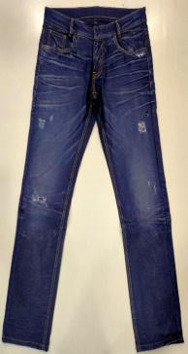
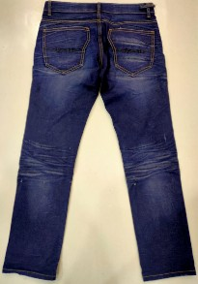
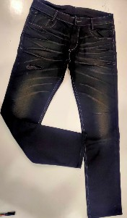
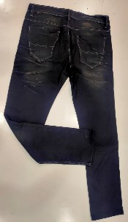


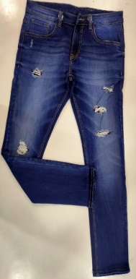
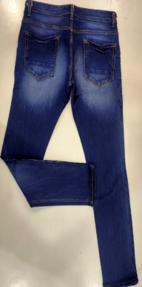
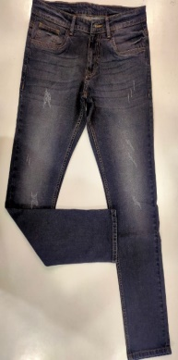
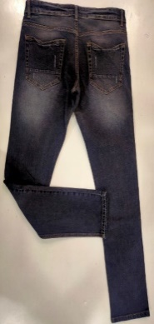


5- Products: Men
VG

Slide 17
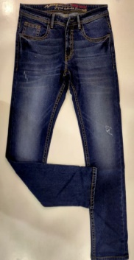
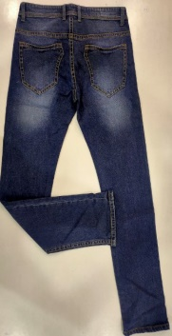
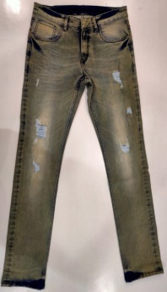
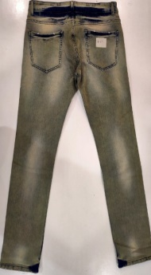


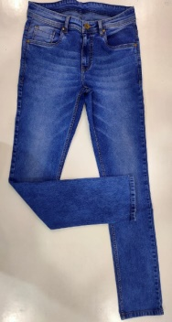
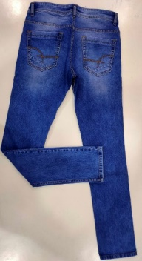
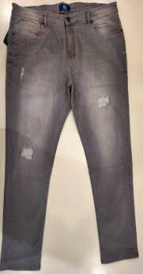
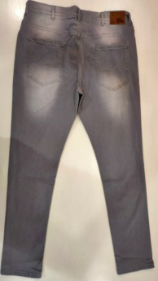


5- Products: Men
VG

Slide 18
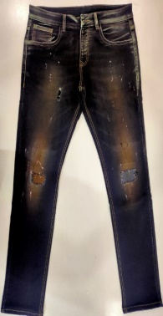
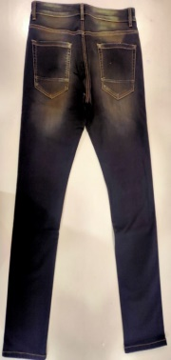
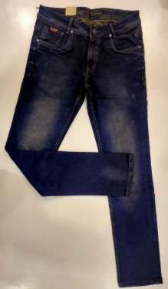
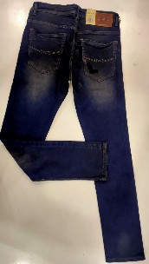


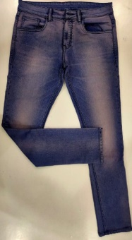
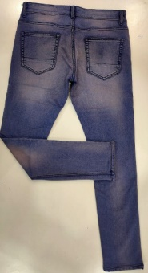
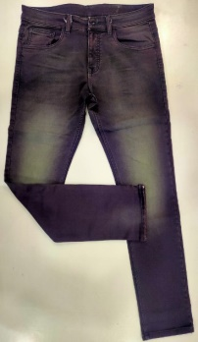
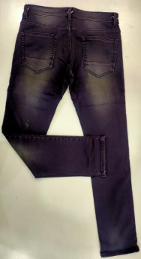


5- Products: Men
VG

Slide 19
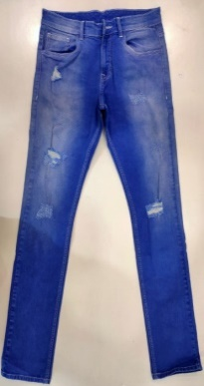
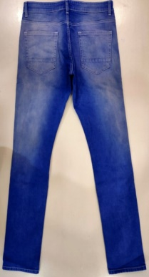
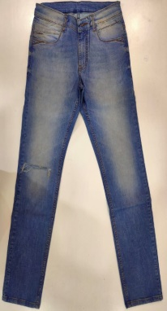
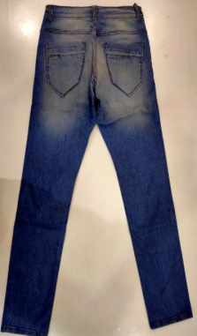



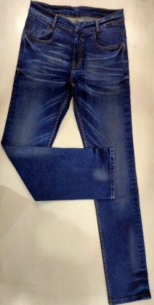
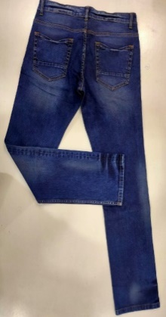
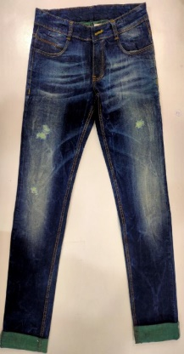
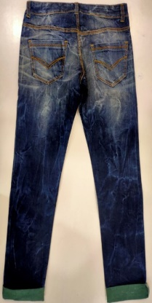


5- Products: Men
VG

Slide 20
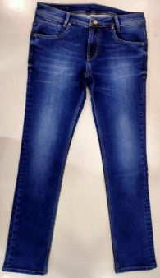
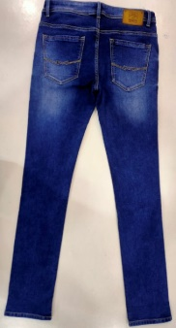
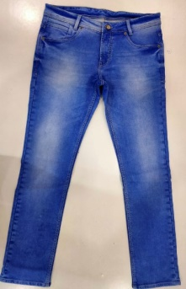
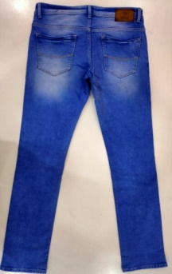



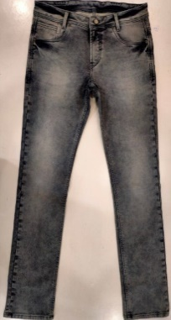
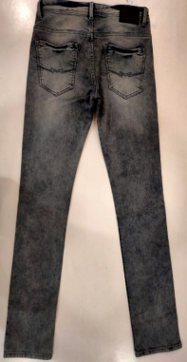
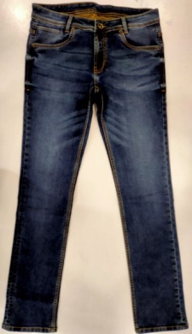
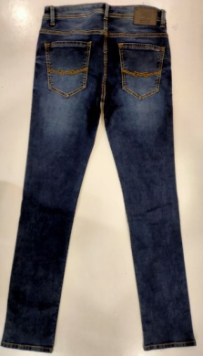


5- Products: Men
VG

Slide 21
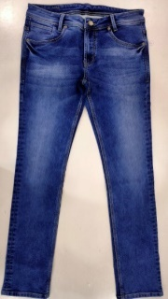
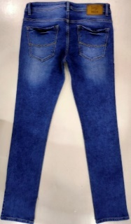
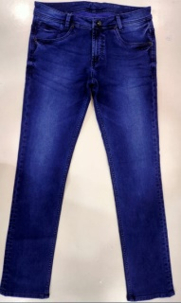
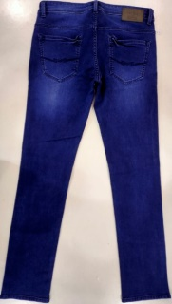
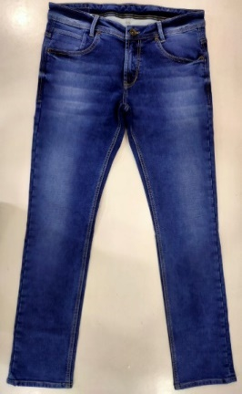
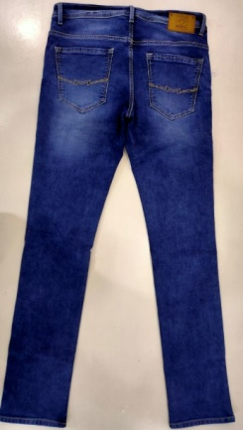

5- Products: Men
VG

Slide 22

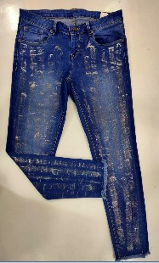
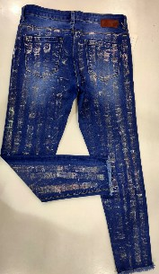










5- Products: Women
VG

Slide 23












5- Products: Women
VG

Slide 24













5- Products: Women
VG

Slide 25












6 – Clientele & Brands
VG

Slide 26

7 – Certifications
VG

Slide 27
8 – Accreditations
VG

Slide 28
9 - Quality Standards
VG
“Vaishnavi” is known for its commitment towards quality manufacturing and has always qualified AQL standards.

Slide 29
10 – Testimonials
VG
“Vaishnavi is always prompt in the quality supply as even with our random orders”…
Mr. ------------------, Myntra
“Management and staff of Vaishnavi is our asset as supplier”...
Mr. ------------------, Mufti
“We can always rely and depend upon the Vaishnavi for our requirement of supplies, they are one of the most professionally managed apparel house we deal with”…
Mr. ------------------, Reliance Retails
“we are very excited to work with them”...
Mr. ------------------, Arvind

Slide 30
11 – Forthcomings
VG
Vaishnavi is planning to expand its base of operations by acquiring one more production unit of 50,000 sq. ft. to meet ever-growing demands.
Production capacity of the company is going to enhance to 3 Lakh pcs per month almost double of its existing capacity.
System and machinery installations will be from some of the best technology suppliers of automation systems.
Company is also entering into a joint venture for the export supplies.

Slide 31

VG
Vaishnavi and its team thanks you for giving us your valuable time…
C 237/239, Turbhe MIDC, Turbhe, Navi Mumbai – 400705.
Mr. Rishi Mehra-CMD : +91 982 118 6773

